Slide 1
Recursion
Chapter 5

Slide 2
Objectives
Recursive definition
Method calls and recursion implementation
Anatomy of a recursive call
Tail recursion
Non-tail recursion
Indirect recursion (*)
Nested recursion (*)
Excessive recursion
Backtracking (*)
Reading at home
Notes:
(*) Means that students are required to understand essential features only (the problem explaination, definitions, the outline of algorithms…), not in details.

Slide 3
Recursion definitions and examples
Definitions, convert to binary, and factorial examples

Slide 4
Recursive definition
Recursive definition or inductive definition
Defining something in term of itself
For it to work, the definition must
Well-founded
Avoid infinite regress
It consists of at least two parts
Base case (ground case) that doesn’t reference to itself
Inductive case contains a reference to its own type

Slide 5
Recursive program/algorithm
Recursive program/algorithm is one that calls itself
There are three basic rules for developing recursive algorithms
Know how to take one step
Break each problem down into one step plus a smaller problem
Know how and when to stop

Slide 6
Convert to binary example
/2
/2
/2
/2
Stop
10
5
2
1
0
%2
%2
%2
%2
0
1
0
1
return
return
return
return
print
print
print
print
0
1
0
1
Values
2⁰
2¹
2²
2³

Slide 7
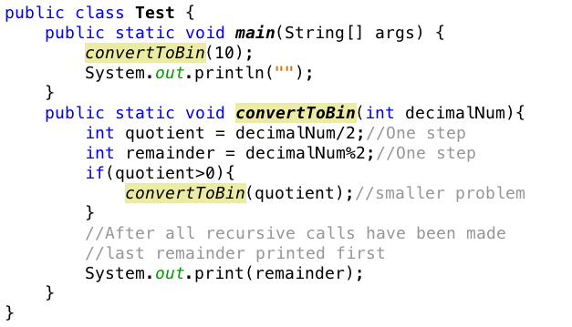
Convert to binary example

Slide 8
Recursion application
Recursive definitions are used in defining functions or sequences of elements
Purpose of recursive definition
Generating new elements
Testing whether an element belongs to a set (*)
(*) The problem is solved by reducing it to a simpler problem

Slide 9
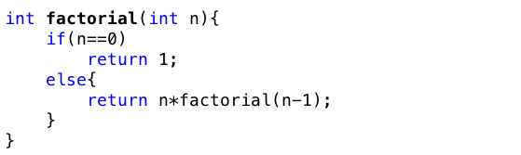
Example – factorial calculation
Factorial of number n definition
Denoted as: n!
Equals: 1 if n = 0 (anchor/sentinel point)
Equals: n*(n-1)! If n>0 (inductive step)

Slide 10
Method calls and recursion implementation

Slide 11
How does recursion actually work?
Each time a method is called, an activation record (AR) is allocated for it.
This record contains the following information
Parameters and local variables used in the called method
Dynamic link: a pointer to the caller’s activation record
Return address to resume control by the caller (address of instruction immediately following the call)
Return value for a method not declared as void.
Since the size of AR may vary from one call to another, returned value is placed right above the AR of the caller

Slide 12
How does recursion actually work?
Each new AR is placed on top of the run-time stack
When a method terminates, its AR is removed from the top of the run-time stack
Thus, the first AR placed on the stack is the last one removed.

Slide 13
Creating an activation record
Creating an activation record
Whenever a method is called
Allows system to handle recursion properly
Recursion is calling a method that happens to have the same name as the caller
Recursive call is not literally calling itself
These invocations are presented internally by different activation records

Slide 14
Anatomy of a recursive call
N = 1
N <= 1 ? Yes
return 1;
factorial(1)
1
N = 2
N <= 1 ? No
return 2*factorial(1);
factorial(2)
2
N = 3
N <= 1 ? No
return 3*factorial(2);
factorial(3)
6
N = 4
N <= 1 ? No
return 4*factorial(3);
factorial(4)
24
First call

Slide 15
Direct recursion
Tail recursion, Non-tail recursion

Slide 16
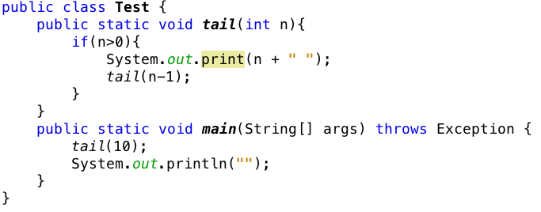
Tail recursion
There is only one recursive call at the very end of a method implementation.

Slide 17
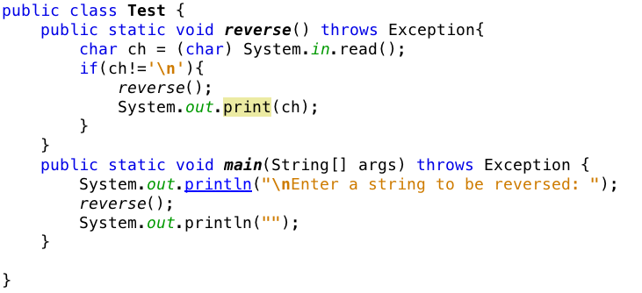
Non-tail recursion
The recursive call not at every end of a method implementation

Slide 18
Converting recursion to iterative

Slide 19
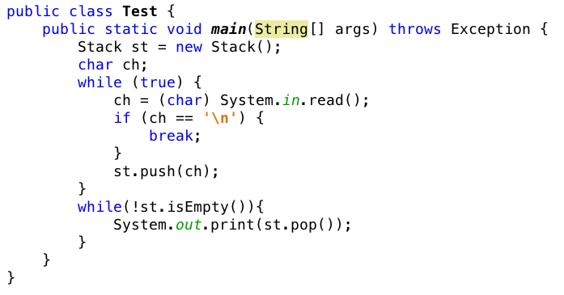
Example

Slide 20
OTHER recursion TYPES (required to understand essential features only)
Indirect recursion, Nested recursion, Excessive recursion, etc

Slide 21
Indirect recursion
If f() calls itself, it is direct recursive
If f() calls g(), and g() calls f(). It is indirect recursion
The chain of intermediate calls can be of an arbitrary length
f() -> f1() -> f2() -> … -> f(n) -> f()

Slide 22


Nested recursion
A function is not only defined in terms of itself but also is used as one of the parameters
Consider the following example
Another example, Ackermann’s function

Slide 23

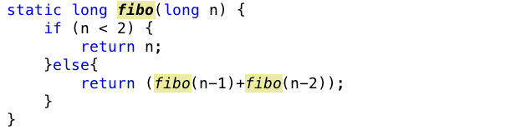
Excessive recursion
Consider Fibonacci sequence of numbers
This looks very natural but is very inefficient implementation

Slide 24
Tree calls of fibo
fib(4)
fib(3)
fib(2)
fib(1)
fib(0)
fib(2)
fib(1)
1
0
fib(1)
fib(0)
1
1
0

Slide 25
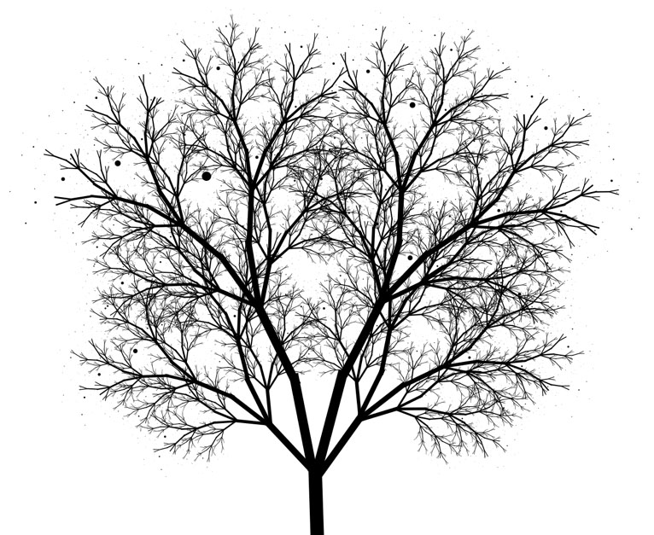
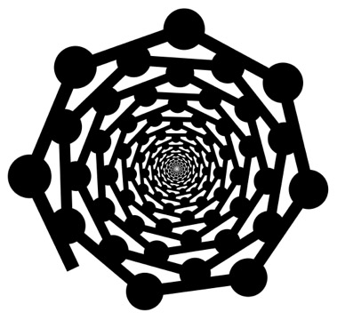
Drawing fractals

Slide 26
RECURSIVE Characteristics
Recursive vs. Iteration, Back tracking

Slide 27
Recursion vs. Iteration
Some recursive algorithms can also be easily implemented with loops
When possible, it is usually better to use iteration
Since we don’t have the overhead of run-time stack
Other recursive algorithms are very difficult to do any other way

Slide 28
Back tracking
In solving some problems
There are different ways leading from a given position
None of them known to lead to a solution.
After trying one path unsuccessfully
Return to this crossroad and
Try to find a solution using another path.
We must ensure
Such a return is possible and
All paths can be tried.
Technique is called backtracking.
This technique is used in artificial intelligence
One of the problem which backtracking is very useful is the n-queens problem

Slide 29
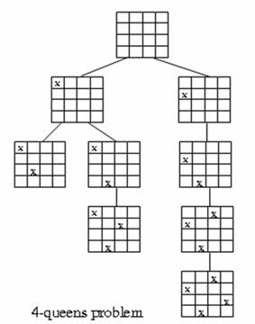
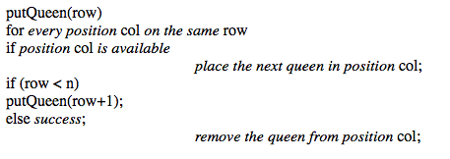
4-queens problem
Each choice leads to another set of choices.
Make one choice and continue.
If you reach a dead end, go back to previous choice and try next alternative.

Slide 30
4-queens problem

Slide 31
Reading at home
See the book

Slide 32
Summaries
Recursive definition
Method calls and recursion implementation
Anatomy of a recursive call
Tail recursion
Non-tail recursion
Indirect recursion (*)
Nested recursion (*)
Excessive recursion
Backtracking (*)
Reading at home
Notes:
(*) Means that students are required to understand essential features only (the problem explaination, definitions, the outline of algorithms…), not in details.

